Slide 1
Web Design Fundamentals /
Basic Web Design
HTML Formatting Tags – ITWD103 / ITWD113

Slide 2
Let’s try more samples for:
The <body> tag is required for all HTML documents and defines the area where the document’s content is contained.
You can also use the <body> tag to define some of the formatting for the entire page.
Attributes taken by the <body> tag include bgcolor, background, text, link, vlink, alink, as well as margins.

Slide 3
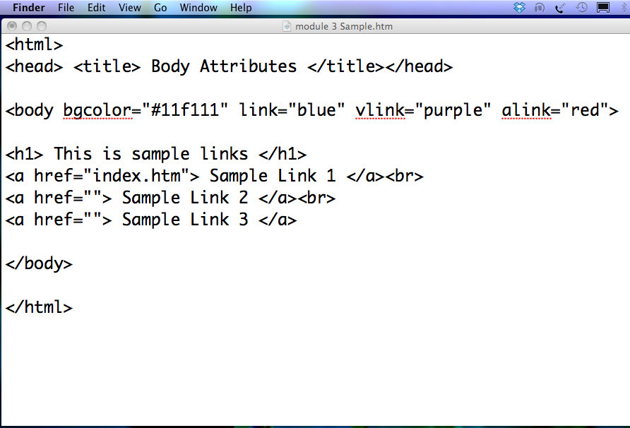
Save as : surname_bodyTag.htm
Observe output.

Slide 4
Basic Text Formatting Tags
Tag | Closing | Description
<b> | </b> | Creates bold text.
<i> | </i> | Creates italicized text.
<u> | </u> | Underlines text (use with caution).
<big> | </big> | Big text. Can be overlapped (a bigger big).
<small> | </small> | Small text. Can be overlapped (a smaller small).

Slide 5
THE <FONT> TAG
The most-used method to change the look of text on web sites is through the use of the <font> tag.
The <font> tag has three attributes:
face – controls the font type
size – controls the font size (range from 1 – 7)
color – controls the color
The use of <font> is deprecated in favor of style sheets in HTML 4.

Slide 6
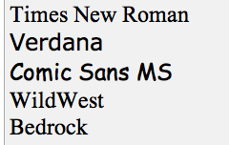
<FONT face=“”>
<font face="Times New Roman" size="5">Times New Roman</font>
<font face="Verdana" size="5">Verdana</font>
<font face="Comic sans MS" size="5">Comic Sans MS</font>
<font face="WildWest" size="5">WildWest</font>
<font face="Bedrock" size="5">Bedrock</font>

Slide 7
The Comment Tag
It is always a good practice ro add comments to an HTML page that does not show up on the browser, you can use the following:
Try to write this in your text editor:
<!-- Text Here -->
If you do not close your comment tag, the rest of your page will be invisible.

Slide 8
The <hr> Tag
The <hr> tag helps structure your web page by inserting horizontal rule lines.
Attributes:
align – controls alignment (center, left, right).
noshade – displays the rule without shading.
<hr noshade>
size – controls the size (the height) of the rule.
width – controls the length of the rule.
color – the color of the rule (Internet Explorer).

Slide 9
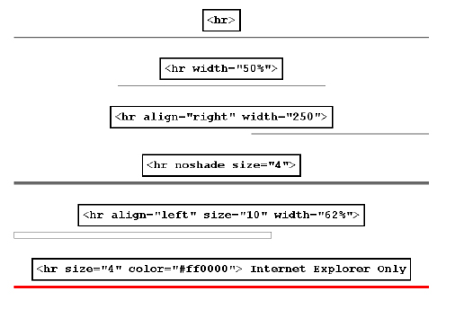

Slide 10
TEXT FORMATTING TAGS TO TRY
Tag Description
<b> Defines bold text
<big> Defines big text
<em> Defines emphasized text
<I> Defines italic text
<small> Defines small text
<strong> Defines strong text
<sub> Defines subscripted text
<sup> Defines superscripted text
<ins> Defines inserted text
<del> Defines deleted text
<s> Deprecated. Use <del> instead
<strike> Deprecated. Use <del> instead
<u> Defines underlined text

Slide 11
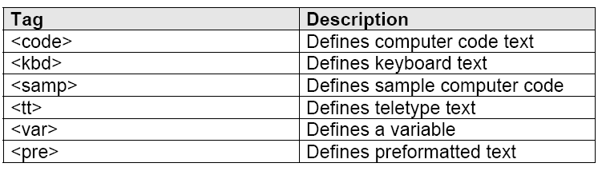
COMPUTER "OUTPUT" TAGS

Slide 12
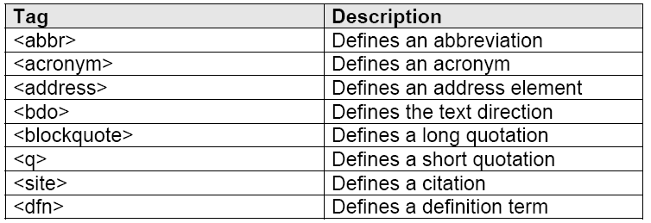
Citations, Quotations, and Definition Tags

Slide 13
The HTML <marquee> tag
This is used for scrolling piece of text or image displayed either horizontally across or vertically down your web site page depending on the settings.

Slide 14
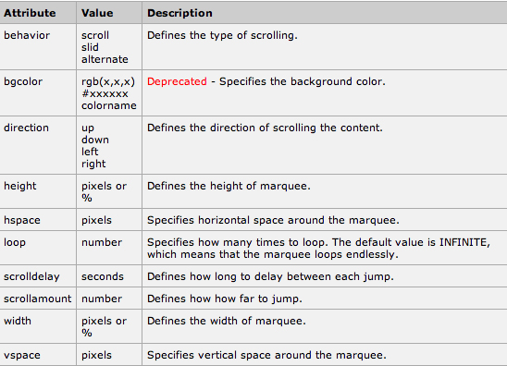
<marquee> Attributes

Slide 15
LIST

Slide 16
List appear in web browser as bulleted lines of text including unordered list (bullets), ordered list (numbers) and definition list (dictionaries).

Slide 17
An unordered list starts with the <ul> tag. Each list item starts with the <li> tag.
<ul>
<li>Coffee</li>
<li>Milk</li>
</ul>
Here is how it looks in a browser:
• Coffee
• Milk
Inside a list item you can put paragraphs, line breaks, images, links, other.
Unordered Lists <ul>, <li>

Slide 18
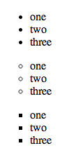
Types of UNORDERED LIST
<ul type=“disc”> default
<ul type=“circle”>
<ul type=“square”>

Slide 19
An ordered list starts with the <ol> tag. Each list item starts with the <li> tag.
<ol>
<li>Coffee</li>
<li>Milk</li>
</ol>
Here is how it looks in a browser:
1. Coffee
2. Milk
Inside a list item you can put paragraphs, line breaks, images, links, other.
Ordered Lists <ol>, <li>

Slide 20

Types of ORDERED LIST
<ol> default
<ol type=“A”>
<ol type=“a”>
<ol type=“I”>
<ol type=“i”>

Slide 21
Description List <dl>, <dt>, <dd>
A description list is a list of terms/names, with a description of each term/name.
The <dl> tag defines a description list.
The <dl> tag is used in conjunction with <dt> (defines terms/names) and <dd> (describes each term/name)

Slide 22

Definition List Sample
<dl>
<dt>Coffee</dt>
<dd>- black hot drink</dd>
<dt>Milk</dt>
<dd>- white cold drink</dd>
</dl>

Slide 23
HTML Entities
Reserved characters in HTML must be replaced with character entities. Characters, not present on your keyboard, can also be replaced by entities.

Slide 24
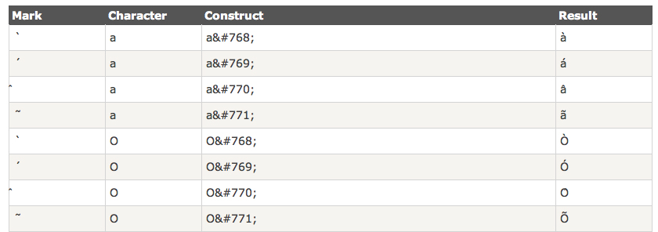

Slide 25
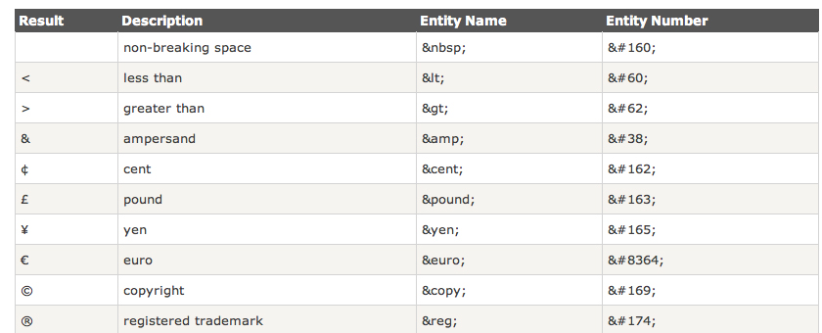

Slide 26
End of Module

